Slide 1
OS Introduction 5 Security, Virtualization, Distributed System
David Liu
Fall 2021, Spring 2022

Slide 2
Learning Objectives
Discuss the role and importance of operating systems
Describe the general organization of a computer system and the role of interrupts
Describe the components in a modern, multiprocessor computer system
Illustrate the transition from user mode to kernel mode
Discuss how OS manages computing resources
Distinguish between protection and security
Describe common data structures for OS
Discuss how operating systems are used in various computing environments
Provide examples of free and open-source operating systems

Slide 3
Security and Protection
Protection
Control access of processes or users to resource
Internal threats
Typically authorized vs unauthorized usage
Security
Mostly external threats
User authentication
Denial of service, worms, viruses, identity theft

Slide 4
Emulation vs Virtualization
Emulation
Simulate hardware in software: MS Word for Intel x86 CPU to run on ARM CPU (different CPU types)
Interpretation
Virtualization
Guest and host OS natively compiled for the same CPU type
Virtual machine manager for virtualization services

Slide 5
VMM without Host OS

Slide 6
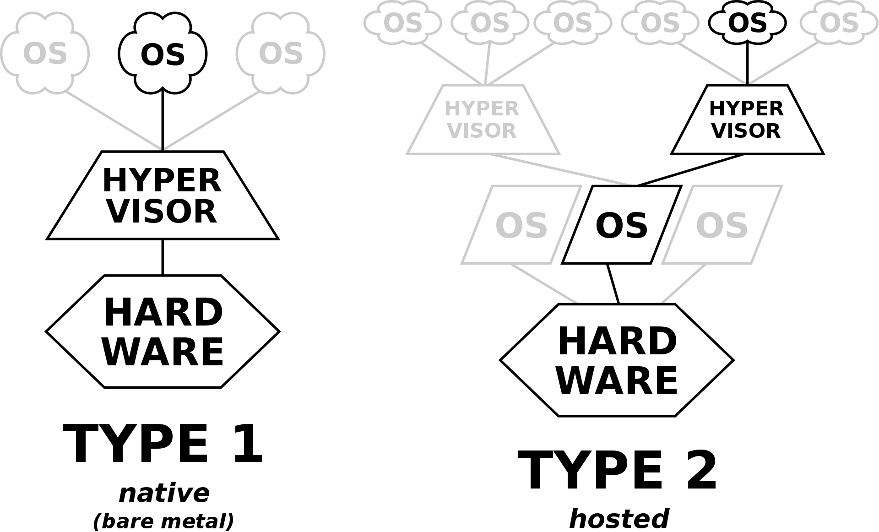
Hypervisor
https://en.wikipedia.org/wiki/Hypervisor

Slide 7
Distributed Systems
Distributed system
A collection of physically separate, possibly heterogeneous computer systems
Networked
Users to access to various resources
NOS – Network Operating Systems
File sharing across the network
Different processes on different computers to exchange messages
Illusion of a single system

